Slide 1
Network Layer

Slide 2
Where are we now?
Introduction to Networking
Basic Queuing Theory
Application Layer
Transport Layer
Network Layer
Data Link Layer
Medium Access Control SubLayer
Physical Layer
Further subjects (we will decide what to talk about based on the time left at the end of the semester)

Slide 3


Layered Architecture: Application Layer
host or
server
host or
server
application
transport
controlled by
app developer
application
transport
process
process
Ankara
Internet
Pittsburgh
Application: Firefox
Application data: Jpeg image, HTML text
Application layer protocol: HTTP
Defines the rules to communicate the application data between the processes
Application layer: Only exists at the end systems
needs the HTTP messages to be transmitted from sender process to receiver process
Gives the HTTP messages to the transport layer

Slide 4
Layered Architecture: Transport Layer
host or
server
host or
server
controlled by
app developer
application
transport
network
application
transport
network
process
process
Ankara
Internet
Pittsburgh
Transport layer protocol: TCP/UDP
Encapsulates application layer messages in segments
Transmits the data from sender process to receiver process
Transport layer: Only exists at the end systems
Needs the segments to be transmitted from sender host machine to receiver host machine
Gives the segments to the network layer

Slide 5
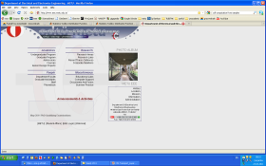
Layered Architecture: Network Layer
User data
D
Provides Connectivity
the service of sending the segment from sending to receiving host
message
H_{A}
D
application
transport
network
segment
H_{T}
H_{A}
D
datagram
H_{N}
H_{T}
H_{A}
D
source
D
We will focus on the most commonly used network layer protocol: Internet Protocol (IP)
destination
H_{A}
D
application
transport
network
H_{T}
H_{A}
D
H_{N}
H_{T}
H_{A}
D
Notes:
5

Slide 6
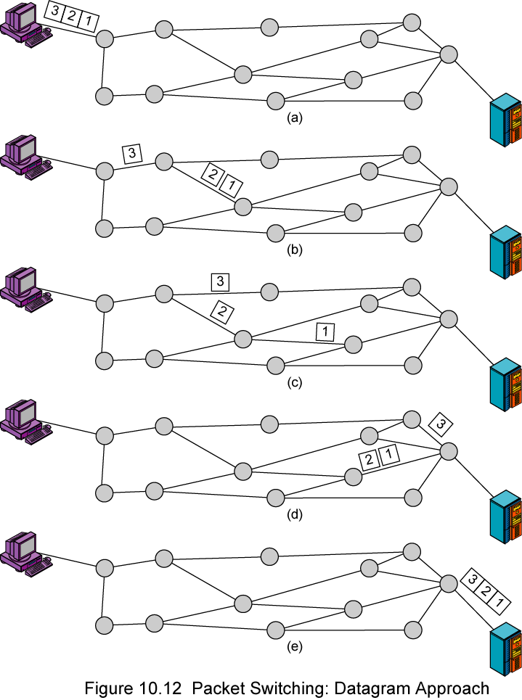
IP Connectionless Service
packets forwarded using destination host address
packets between same source-dest pair may take different paths

Slide 7
Network layer
transport segment from sending to receiving host
Addressing:
Each device interface to network has an IP address
Addressing hierarchically visible to the entire network
network layer protocols in every host, router
uses the services of the Data Link Layer
application
transport
network
data link
network
data link
network
data link
network
data link
network
data link
network
data link
network
data link
network
data link
l
network
data link
application
transport
network
data link

Slide 8
The Internet Network layer
Host, router network layer functions:
Transport layer: TCP, UDP
Routing protocols
path selection
RIP, OSPF, BGP
IP protocol
addressing conventions
datagram format
packet handling conventions
Network
layer
forwarding
table
ICMP protocol
error reporting
router “signaling”
Link layer
physical layer

Slide 9
Two key network-layer functions
routing: determine route taken by packets from source to dest.
routing algorithms
forwarding: move packets from router’s input to appropriate router output
analogy:
forwarding: process of getting through single interchange
routing: process of planning trip from source to dest

Slide 10
IP Router and IP address lookup
routing algorithm determines
end-end-path through network
routing algorithm
IP lookup table
Table lookup
for each packet
dest address
output link
address 1
address 2
address 3
address 4
3
2
2
1
IP destination address in
arriving packet’s header
1
3
2

Slide 11
Router Packet Processing
Header Processing
Data
Hdr
Lookup
Address
Update
Header
Queue
Packet
Data
Hdr
IP Address
Next Hop
Address
Table
Address | Output Port-Action
A | 1, Mark high priority
B | 1
C | 2
~1M prefixes
Off-chip DRAM

Slide 12
Routing Table / Forwarding Table
Routing Table
The complete table
Updated by the routing algorithms
Software management
Forwarding Table
Local sometimes partial copy of the routing table
Look up for every packet
Hardware management

Slide 13
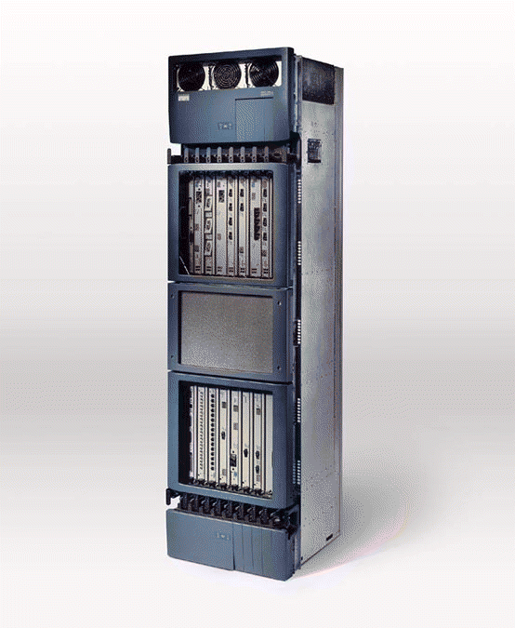
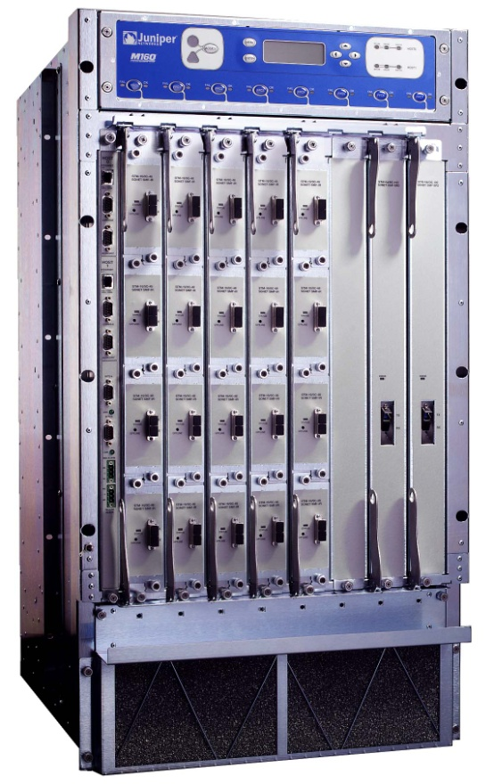
What does a Router look like?
Cisco GSR 12416
Juniper M160
19”
19”
Capacity: 160Gb/s Power: 4.2kW
Capacity: 80Gb/s Power: 2.6kW
6ft
3ft
2ft
2.5ft

Slide 14
Router architecture overview
two key router functions:
run routing algorithms/protocol (RIP, OSPF, BGP)
forwarding datagrams from incoming to outgoing link
forwarding tables computed,
pushed to input ports
routing
processor
routing, management
control plane (software)
forwarding data plane (hardware)
high-seed
switching
fabric
Input port and output port
on a single Line card
router input ports
router output ports

Slide 15
Switching fabrics
transfer packet from input buffer to appropriate output buffer
switching rate: rate at which packets can be transfer from inputs to outputs
often measured as multiple of input/output line rate
N inputs: switching rate N times line rate desirable
three types of switching fabrics
memory
memory
bus
crossbar

Slide 16
Output ports
datagram
buffer
queueing
switch
fabric
link
layer
protocol
(send)
line
termination
buffering required when datagrams arrive from fabric faster than the transmission rate
scheduling discipline chooses among queued datagrams for transmission

Slide 17
How much buffering?
RFC 3439 rule of thumb: average buffering equal to “typical” RTT (say 250 msec) times link capacity C
e.g., C = 10 Gpbs link: 2.5 Gbit buffer
recent recommendation: with N flows, buffering equal to
.
RTT C
N

Slide 18

Routers and the Layered Architecture
application
transport
network
data link
physical
End systems implement the entire network stack
Including application and transport layers
The routers implement only network layer and lower layers
network
data link
physical
network
data link
physical
network
data link
physical
network
data link
physical
network
data link
physical
network
data link
physical
network
data link
physical
network
data link
physical
network
data link
physical
application
transport
network
data link
physical
network
data link
physical
network
data link
physical

Slide 19
IP datagram format
IP protocol version
number
header length
(bytes)
Priority
Assigned by the sender to aid in assembling the fragments of a datagram
32 bits
total datagram
length (bytes)
ver
head.
len
type of
service
length
for
fragmentation/
reassembly
flgs
fragment
offset
16-bit identifier
max number
remaining hops
(decremented at
each router)
time to
live
upper
layer
header
checksum
32 bit source IP address
upper layer protocol
to deliver payload to
32 bit destination IP address
options (if any)
e.g. timestamp,
record route
taken, specify
list of routers
to visit.
data
(variable length,
typically a TCP
or UDP segment)
how much overhead?
20 bytes of TCP
20 bytes of IP
= 40 bytes + app layer overhead

Slide 20
IP Addressing
interface: connection between host/router and physical link
router’s typically have multiple interfaces
host may have multiple interfaces
IP addresses associated with each interface
IP address: 32-bit identifier for host, router interface
223.1.1.1
223.1.2.1
223.1.1.2
223.1.1.4
223.1.2.9
223.1.2.2
223.1.1.3
223.1.3.27
223.1.3.1
223.1.3.2
223.1.1.1 = 11011111 00000001 00000001 00000001
223
1
1
1

Slide 21
What does a forwarding table look like?
DOESN’T WORK
Address | Outgoing Interface
144.122.144.188 | Interface 1
128.2.42.10 | Interface 2
171.64.13.26 | Interface 2
144.122.150.76 | Interface 1
83.66.162.3 | Interface 3
Interface 3
Interface 1
Interface 2
IP packets carry 32 bit destination host addresses
Can the router keep track of all individual destination host addresses?

Slide 22
What does a forwarding table look like?
Network Address | Outgoing Interface
METU | Interface 1
CMU | Interface 2
STANFORD | Interface 2
COMPANY 1 | Interface 3
Interface 3
Interface 1
Interface 2
Routers keep the addresses of networks
Router sends the IP packet to its destination network
Once the packet reaches its destination network, it is delivered to its final destination host with another mechanism (we discuss later)
Q1: How do we represent the addresses of the networks?

Slide 23
IP Addresses and Network Addresses
Look at these two IP addresses from METU:
144.122.144.188 144.122.150.76
IP addresses of all hosts in a network begin with the same block of bits
Host IP addresses are given from a contiguous IP address block
A1: The network address is a number of most significant bits of the IP address
Network
address
Host Address
Network
address
Host Address

Slide 24
What does a forwarding table look like?
Network Address | Outgoing Interface
METU | Interface 1
CMU | Interface 2
STANFORD | Interface 2
COMPANY 1 | Interface 3
Address (begins with) | Outgoing Interface
144.122 | Interface 1
128.2 | Interface 2
171.64 | Interface 2
83.66.162 | Interface 3
Q2: How does the router represent the network addresses in the routing table?
A2: Routers use a group of most significant bits of 32 bit IP addresses to represent the network addresses in the table.

Slide 25
How does the router look up an IP packet?
Network Address | Outgoing Interface
METU | Interface 1
CMU | Interface 2
STANFORD | Interface 2
COMPANY 1 | Interface 3
Interface 3
Interface 1
Interface 2
144.122.144.88
IP packets still carry the individual host addresses
Q3: How does the router find out about the destination network from the IP packet?

Slide 26
IP Addresses and Network Addresses
A3: The router should find how many most significant bits make up the network address for an incoming IP packet.
Then it can extract the network address

Slide 27
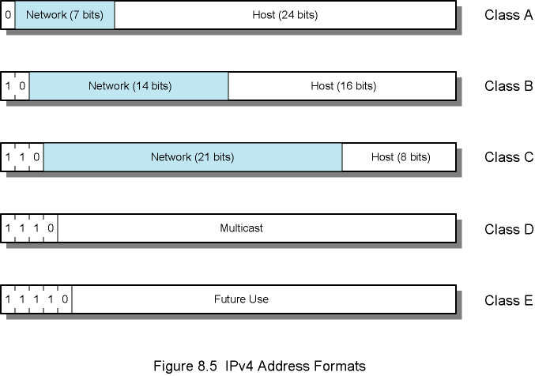
Network Address finding: How many most significant bits
Class-based address: Coarse network addresses
CIDR: Classless Inter Domain Routing: Network address can take any number of bits

Slide 28
Subnets: Network in CIDR
223.24.0.0/20
What’s a subnet ?
Devices that can physically reach each other without intervening router
How to determine the subnets?
detach each interface from its host or router,
creating islands of isolated networks.
Each isolated network is called a subnet.
Each subnet is assigned a subnet number
Interface 1
Interface 2
Interface 3
223.24.8.0/22
223.24.16.0/21

Slide 29
Subnets and addressing
IP address:
subnet part (high order bits)
host part (low order bits)
Subnet addresses:
All interfaces in the subnet have the same subnet part
Subnet address in human readable form:
223.24.16.0/21
Binary:
11011111 00011000 00010000 00000000
Host address: 223.24.19.167
11011111 00011000 00010011 10100111
Host address: 223.24.23.15
11011111 00011000 00010111 00001111
223.24.0.0/20
Interface 1
Interface 2
Interface 3
223.24.8.0/22
223.24.16.0/21
223.24.19.167
223.24.23.15

Slide 30
IP addressing: CIDR
subnet
part
host
part
11011111 00011000 00010000 00000000
First 21 bits of 223.24.16.0
How many hosts can exist in this subnet?
Subnet part=21 bits
Hosts part=32-21=11 bits
2¹¹=2K hosts
Notes:
address format: a.b.c.d/x
x is # bits in subnet portion of address (Higher order bits)
Less significant 32-x bits are represented as 0

Slide 31
IP addressing: CIDR
CIDR: Classless InterDomain Routing
Used in the routers’ forwarding tables
subnet portion of address of arbitrary length
Logical:
Subnet address: 11011111 00011000 00010 (21 bits)
Represented as: 223.24.16.0/21 (for humans)
subnet
part
host
part
11011111 00011000 00010000 00000000
First 21 bits of 223.24.16.0
Q: How can the router represent subnet addresses in the routing table?
Notes:
address format: a.b.c.d/x
x is # bits in subnet portion of address (Higher order bits)
Less significant 32-x bits are represented as 0

Slide 32
IP addressing: CIDR
A: Each network address is stored with a Subnet mask
Bit pattern to be AND’ed with the 32 bit address
Indicates which bits are subnet number and which are host number
Lining up the IP address and the subnet mask together, the network and host portions of the address can be separated
DETERMINES THE SUBNET ADDRESS FOR AN IP ADDRESS
subnet
part
host
part
11011111 00011000 00010000 00000000
First 21 bits of 223.24.16.0
Address | Mask
11011111 00011000 00010000 00000000 | 11111111 11111111 11111000 00000000
Notes:
address format: a.b.c.d/x
x is # bits in subnet portion of address (Higher order bits)
Less significant 32-x bits are represented as 0

Slide 33
Routing Table IP lookup
Interface 1
Interface 2
Subnet | Interface
223.24.0.0/20 | 1
223.24.8.0/22 | 2
223.24.16.0/21 | 3
Interface 3
Subnet A:
223.24.0.0/20
Subnet B:
223.24.8.0/22
Logical
Subnet C:
223.24.16.0/21
Actual
Address | Mask | Int
11011111 00011000 00000000 00000000 | 11111111 11111111 11110000 00000000 | 1
11011111 00011000 00001000 00000000 | 11111111 11111111 11111100 00000000 | 2
11011111 00011000 00010000 00000000 | 11111111 11111111 11111000 00000000 | 3

Slide 34
CIDR –Look-up: Example 1
Subnet | Interface
223.24.0.0/20 | 1
223.24.8.0/22 | 2
223.24.16.0/21 | 3
ROUTER’S FORWARDING TABLE
Address Mask
A: 11011111 00011000 00000000 00000000 11111111 11111111 11110000 00000000
B: 11011111 00011000 00001000 00000000 11111111 11111111 11111100 00000000
C: 11011111 00011000 00010000 00000000 11111111 11111111 11111000 00000000
A packet comes in addressed to 223.24.19.167
Binary: 11011111 00011000 00010011 10100111
Packet address is Boolean ANDed with Subnet A mask 11011111 00011000 00010011 10100111
11111111 11111111 11110000 00000000
11011111 00011000 00010000 00000000
A:11011111 00011000 00000000 00000000
Dest Address
BOOL AND
Mask of A
AND Result
NO MATCH!
A address

Slide 35
CIDR –Look-up: Example 1
Subnet | Interface
223.24.0.0/20 | 1
223.24.8.0/22 | 2
223.24.16.0/21 | 3
ROUTER’S FORWARDING TABLE
Address Mask
A: 11011111 00011000 00000000 00000000 11111111 11111111 11110000 00000000
B: 11011111 00011000 00001000 00000000 11111111 11111111 11111100 00000000
C: 11011111 00011000 00010000 00000000 11111111 11111111 11111000 00000000
A packet comes in addressed to 223.24.19.167
Binary: 11011111 00011000 00010011 10100111
Packet address is Boolean ANDed with Subnet B mask 11011111 00011000 00010011 10100111
11111111 11111111 11111100 00000000
11011111 00011000 00010000 00000000
B:11011111 00011000 00001000 00000000
Dest Address
BOOL AND
Mask of B
AND Result
NO MATCH!
B address

Slide 36
CIDR –Look-up: Example 1
Subnet | Interface
223.24.0.0/20 | 1
223.24.8.0/22 | 2
223.24.16.0/21 | 3
ROUTER’S FORWARDING TABLE
Address Mask
A: 11011111 00011000 00000000 00000000 11111111 11111111 11110000 00000000
B: 11011111 00011000 00001000 00000000 11111111 11111111 11111100 00000000
C: 11011111 00011000 00010000 00000000 11111111 11111111 11111000 00000000
A packet comes in addressed to 223.24.19.167
Binary: 11011111 00011000 00010011 10100111
Packet address is Boolean ANDed with Subnet C mask
11011111 00011000 00010011 10100111
11111111 11111111 11111000 00000000
11011111 00011000 00010000 00000000
C:11011111 00011000 00010000 00000000
Dest Address
BOOL AND
Mask of C
AND Result
C address
MATCH!
->Forward
to
interface
3

Slide 37
CIDR –Look-up: Example 2
Subnet | Interface
223.24.0.0/20 | 1
223.24.8.0/22 | 2
223.24.16.0/21 | 3
ROUTER’S FORWARDING TABLE
Address Mask
A: 11011111 00011000 00000000 00000000 11111111 11111111 11110000 00000000
B: 11011111 00011000 00001000 00000000 11111111 11111111 11111100 00000000
C: 11011111 00011000 00010000 00000000 11111111 11111111 11111000 00000000
A packet comes in addressed to 223.24.11.196
Binary: 11011111 00011000 00001011 11000100
Packet address is Boolean ANDed with Subnet A mask
11011111 00011000 00001011 11000100
11111111 11111111 11110000 00000000
11011111 00011000 00000000 00000000
A:11011111 00011000 00000000 00000000
Dest Address
BOOL AND
Mask of A
AND Result
MATCH!
A address

Slide 38
CIDR –Look-up: Example 2
Subnet | Interface
223.24.0.0/20 | 1
223.24.8.0/22 | 2
223.24.16.0/21 | 3
ROUTER’S FORWARDING TABLE
Address Mask
A: 11011111 00011000 00000000 00000000 11111111 11111111 11110000 00000000
B: 11011111 00011000 00001000 00000000 11111111 11111111 11111100 00000000
C: 11011111 00011000 00010000 00000000 11111111 11111111 11111000 00000000
A packet comes in addressed to 223.24.11.196
Binary: 11011111 00011000 00001011 11000100
Packet address is Boolean ANDed with Subnet B mask
11011111 00011000 00001011 11000100
11111111 11111111 11111100 00000000
11011111 00011000 00001000 00000000
B: 11011111 00011000 00001000 00000000
Dest Address
BOOL AND
Mask of B
AND Result
MATCH!
B address

Slide 39
CIDR –Look-up: Example 2
Subnet | Interface
223.24.0.0/20 | 1
223.24.8.0/22 | 2
223.24.16.0/21 | 3
ROUTER’S FORWARDING TABLE
Address Mask
A: 11011111 00011000 00000000 00000000 11111111 11111111 11110000 00000000
B: 11011111 00011000 00001000 00000000 11111111 11111111 11111100 00000000
C: 11011111 00011000 00010000 00000000 11111111 11111111 11111000 00000000
A packet comes in addressed to 223.24.11.196
Binary: 11011111 00011000 00001011 11000100
Packet address is Boolean ANDed with Subnet C mask
11011111 00011000 00001011 11000100
11111111 11111111 11111000 00000000
11011111 00011000 00001000 00000000
C: 11011111 00011000 00010000 00000000
Dest Address
BOOL AND
Mask of C
AND Result
NO MATCH!
C address

Slide 40
Longest Prefix Match (LPM)
If there is more than one match:
Select the match with longer prefix ➔
A Smaller subnet with less number of hosts
Indicates a more detailed match to destination address
For Example 2:
Match with Subnet A (address of 20 bits, hosts 2¹²) ➔Interface 1
Match with Subnet B (address of 22 bits, hosts 2¹⁰) ➔Interface 2
Select Interface 2

Slide 41
Summary
A_{k}: A k bit subnet addresses:
Represented in 32 bits
Least significant 32-k bits are zero
Representation of A_{k} in the forwarding table:
32 bit subnet address, 32 bit subnet mask
SM(A_{k}): Subnet mask for A_{k} : Most significant k bits are 1, rest are zero

Slide 42
Summary
IP addresses of all hosts in subnet A_{k}:
Start with the same k bits
Differ in the last 32-k bits
Maximum number of hosts=2^{32-k}
Is a host with address H is in A_{k} means:
Are first k bits of H and A_{k} the same?
Check: H AND SM(A_{k})= A_{k}
Remember: The least significant 32-k bits of A_{k} are 0 already

Slide 43
Special IP addresses
IP broadcast address:
255.255.255.255 (limited-reserved)
A message sent to a broadcast address is typically received by all network-attached hosts, rather than by a specific host.
Subnet broadcast address:
"this" host on "this" network
0.0.0.0 (reserved)
subnet
part
host
part
11001000 00010111 00010001 11111111
200.23.17.255

Slide 44
IP addresses: how to get one?
Q: How does a host get IP address?
hard-coded by system admin in a file
Windows: Control Panel\Network and Internet\Network Connections: Adapter Properties, TCP/IPv4
UNIX: /etc/rc.config
DHCP: Dynamic Host Configuration Protocol: dynamically get address from as server
“plug-and-play”
Application layer protocol, runs over UDP

Slide 45
DHCP: Dynamic Host Configuration Protocol
Allows host to dynamically obtain its IP address from network server when it joins network
Can renew its lease on address in use
Allows reuse of addresses (only hold address while connected an “on”)
Support for mobile users who want to join network (more shortly)
Application layer protocol runs over UDP

Slide 46
DHCP client-server scenario
223.1.2.5
A
223.1.1.1
DHCP
223.1.2.1
server
223.1.1.2
223.1.1.4
223.1.2.9
B
223.1.2.2
E
arriving DHCP
client needs
address in this
network
223.1.1.3
223.1.3.27
223.1.3.1
223.1.3.2

Slide 47
DHCP client-server scenario
DHCP server: 223.1.2.5
arriving
client
DHCP discover (UDP)
src : IP: 0.0.0.0, Port: 68
dest.: IP: 255.255.255.255, Port: 67
Allocated IP address: 0.0.0.0
transaction ID: 654
There can be multiple offers if there are multiple DHCP servers
DHCP offer
src: 223.1.2.5, 67
dest: 255.255.255.255, 68
Allocated IP address: 223.1.2.4
transaction ID: 654
Lifetime: 3600 secs
DHCP request
src: 0.0.0.0, 68
dest:: 255.255.255.255, 67
Allocated IP address: 223.1.2.4
transaction ID: 655
Lifetime: 3600 secs
Client accepts an offer and replies
time
DHCP ACK
http://support.microsoft.com/kb/169289
src: 223.1.2.5, 67
dest: 255.255.255.255, 68
Allocated IP address: 223.1.2.4
transaction ID: 655
Lifetime: 3600 secs

Slide 48
DHCP: more than IP address
DHCP can return more than just allocated IP address on subnet:
address of first-hop router for client
name and IP address of DNS sever
network mask (indicating network versus host portion of address)

Slide 49
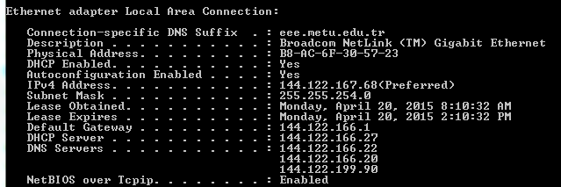
DHCP Example

Slide 50
IP addresses: how to get one?
Q: How does some network get the subnet part of its IP address block?
A: gets allocated portion of its provider ISP’s address space
ISP's block 11001000 00010111 00010000 00000000 200.23.16.0/20
Organization 0 11001000 00010111 00010000 00000000 200.23.16.0/23
Organization 1 11001000 00010111 00010010 00000000 200.23.18.0/23
Organization 2 11001000 00010111 00010100 00000000 200.23.20.0/23
... ….. …. ….
Organization 7 11001000 00010111 00011110 00000000 200.23.30.0/23

Slide 51
Hierarchical addressing: route aggregation
Networks advertise routing information to routers
This information is used to build the routing tables
Hierarchical addressing allows efficient advertisement of routing information:
Organization 0
200.23.16.0/23
Organization 1
200.23.18.0/23
“Send me anything
with addresses
beginning
200.23.16.0/20”
Organization 2
200.23.20.0/23
.
ISP A
.
.
.
.
Internet
Organization 7
.
200.23.30.0/23
ISP B
“Send me anything
with addresses
beginning
199.31.0.0/16”
199.31.0.0/16

Slide 52
Hierarchical addressing: more specific routes
Organization 1 is moved to ISP B
IP addresses of the hosts in Organization 1 are maintained.
Organization 0
200.23.16.0/23
“Send me anything
with addresses
beginning
200.23.16.0/20”
Organization 2
200.23.20.0/23
.
ISP A
.
.
.
.
Internet
Organization 7
.
200.23.30.0/23
Organization 1
ISP B
“Send me anything
with addresses
beginning 199.31.0.0/16
or 200.23.18.0/23”
200.23.18.0/23
199.31.0.0/16

Slide 53
Hierarchical addressing: Longest prefix Match (LPM)
Destination is in Organization 1
11001000 00010111 00010011 10011010 200.23.19.154
11001000 00010111 00010000 00000000 200.23.16.0/20
11001000 00010111 00010010 00000000 200.23.18.0/23
Select Interface 2 with longer prefix match➔ Longer prefix indicates a more detailed match to destination address

Slide 54
IP addressing: the last word...
Q: How does an ISP get block of addresses?
A: ICANN: Internet Corporation for Assigned
Names and Numbers
allocates addresses
manages DNS
assigns domain names, resolves disputes

Slide 55
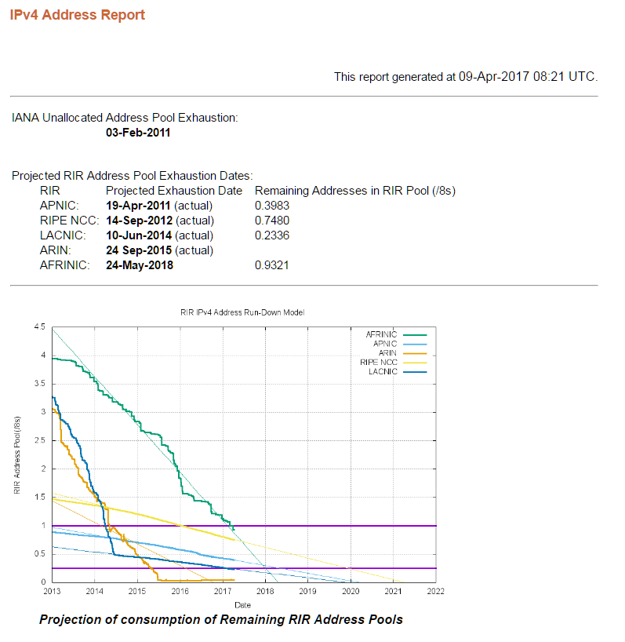
IP Address Allocation
1981 - IPv4 protocol published
1985 ~ 1/16 of total space
1990 ~ 1/8 of total space
1995 ~ 1/3 of total space
2000 ~ 1/2 of total space
2002.5 ~ 2/3 of total space
Conserving effort: Network Address Translation
http://www.potaroo.net/tools/ipv4/index.html

Slide 56
NAT: Network Address Translation
devices inside local net not explicitly addressable, visible by outside world
rest of
Internet
local network
(e.g., home network)
10.0.0/24
10.0.0.1
10.0.0.4
10.0.0.2
138.76.29.7
10.0.0.3
All datagrams leaving local
network have same single source NAT IP address: 138.76.29.7,
different source port numbers
Datagrams with source or
destination in this network
have 10.0.0/24 address for
source, destination (as usual)

Slide 57
NAT: Network Address Translation
Motivation: local network uses just one IP address as far as outside world is concerned:
range of addresses not needed from ISP: just one IP address for all devices
can change addresses of devices in local network without notifying outside world
can change ISP without changing addresses of devices in local network
devices inside local net not explicitly addressable, visible by outside world (a security plus).

Slide 58
NAT: Network Address Translation
NAT translation table
WAN side addr LAN side addr
1: host 10.0.0.1
sends datagram to
128.119.40.186, 80
2: NAT router
changes datagram
source addr from
10.0.0.1, 3345 to
138.76.29.7, 5001,
updates table
138.76.29.7, 5001 10.0.0.1, 3345
…… ……
S: 10.0.0.1, 3345
D: 128.119.40.186, 80
10.0.0.1
1
2
S: 138.76.29.7, 5001
D: 128.119.40.186, 80
10.0.0.4
10.0.0.2
138.76.29.7
S: 128.119.40.186, 80
D: 10.0.0.1, 3345
4
S: 128.119.40.186, 80
D: 138.76.29.7, 5001
3
10.0.0.3
4: NAT router
changes datagram
dest addr from
138.76.29.7, 5001 to 10.0.0.1, 3345
3: Reply arrives
dest. address:
138.76.29.7, 5001

Slide 59

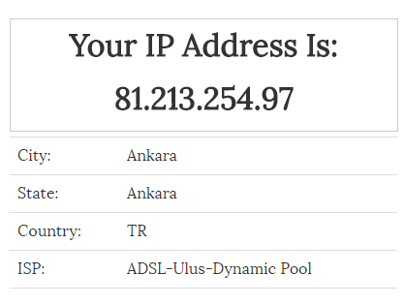
NAT Example
Windows cmd: ipconfig -all
https://www.whatismyip.com/
Try with different devices at home ☺

Slide 60

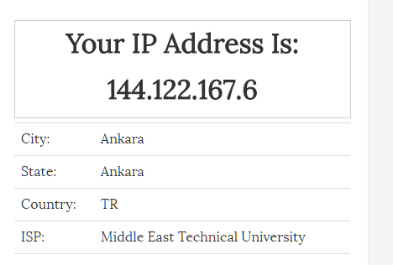
No NAT Example ☺

Slide 61
NAT: Network Address Translation
Implementation: NAT router must:
outgoing datagrams: replace (source IP address, port #) of every outgoing datagram to (NAT IP address, new port #)
. . . remote clients/servers will respond using (NAT IP address, new port #) as destination addr.
remember (in NAT translation table) every (source IP address, port #) to (NAT IP address, new port #) translation pair
incoming datagrams: replace (NAT IP address, new port #) in dest fields of every incoming datagram with corresponding (source IP address, port #) stored in NAT table
16-bit port-number field:
60,000 simultaneous connections with a single LAN-side address!

Slide 62
NAT Problems
NAT is controversial:
routers should only process up to layer 3
NAT breaks “end-to-end communication”
Routers monitor the communication
Routers change the data
NAT breaks “Bi-directional communication”
Hosts with global address can not initiate the communication to the hosts with private address.
Address shortage should instead be solved by IPv6

Slide 63
IPv6
Initial motivation: 32-bit address space soon to be completely allocated.
Additional motivation:
header format helps speed processing/forwarding
header changes to facilitate QoS
IPv6 datagram format:
fixed-length 40 byte header
no fragmentation allowed
Datagrams larger than MTU are dropped

Slide 64
IPv4 & IPv6 Header Comparison
IPv4 Header
IPv6 Header
Version | IHL | Type of Service | Total Length
Identification |  |  | Flags | Fragment Offset
Time to Live |  | Protocol | Header Checksum
Source Address
Destination Address
Options |  |  |  |  | Padding
Version | Traffic Class | Flow Label
Payload Length |  |  | Next Header | Hop Limit
Source Address
Destination Address
- field’s name kept from IPv4 to IPv6
- fields not kept in IPv6
- Name & position changed in IPv6
- New field in IPv6
Legend

Slide 65
Summary of Header Changes between IPv4 & IPv6
Streamlined
Fragmentation fields moved out of base header
IP options moved out of base header
Header Checksum eliminated
Header Length field eliminated
Length field excludes IPv6 header
Alignment changed from 32 to 64 bits
Revised
Time to Live ’ Hop Limit
Protocol ’ Next Header
Precedence & TOS ’ Traffic Class
Addresses increased 32 bits ’ 128 bits
Extended
Flow Label field added

Slide 66
Summary of Main IPv6 Benefits
Expanded addressing capabilities
Structured hierarchy to manage routing table growth
Streamlined header format and flow identification
Improved support for options / extensions
Security - Built-in, strong IP-layer encryption and authentication
Mobility - More efficient and robust mechanisms
Quality of Service
Notes:
Note that Quality of Service is not one of the benefits of IPv6 over IPv4, despite what you may have heard. Both versions of IP have exactly the same QoS features defined. The only difference is the presence of the Flow Label field in IPv6, which allows more efficient packet classification by routers, but this is really a minor implementation optimization, rather than a significant new QoS feature.

Slide 67
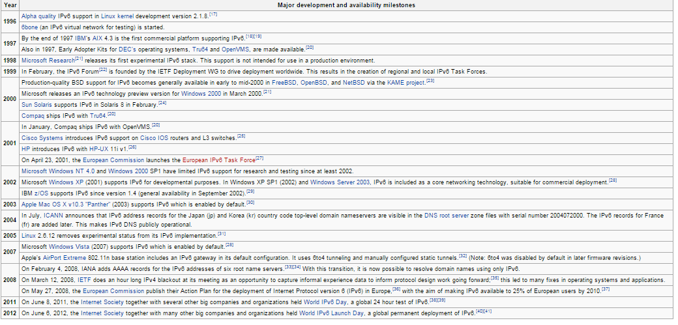
IPv6 History

Slide 68
IPv6 Reality
Started at 1996
2012 World IPv6 Launch Day
the goal for World IPv6 Day was to provide only one percent of users with IPv6 access.
This "is enough traffic to demonstrate that access providers are well advanced in their actual deployment plans.
No one gets the full benefit of IPv6 deployment until everyone supports it.
While IPv6 DNS traffic has tripled over the last year, no significant increase in the percentage of transactions carried over IPv6 for .com and .net
Only deployed because there are no IPv4 address blocks left!

Slide 69
Transition From IPv4 To IPv6
Not all routers can be upgraded simultaneous
How will the network operate with mixed IPv4 and IPv6 routers?
Tunneling: IPv6 carried as payload in IPv4 datagram among IPv4 routers

Slide 70
Tunneling
A
B
E
F
Logical view:
tunnel
IPv6
IPv6
IPv6
IPv6
A
B
E
F
Physical view:
IPv6
IPv6
IPv4
IPv4
IPv6
IPv6

Slide 71
Network Layer

